Slide 1

Minicurso Bioinformática
Prof. Dr. Diego M. Riaño-Pachón

Slide 2
Minicurso Bioinformática
Part I - Intro to bioinformatics, main databases and sequence similarity
Part II – Bioinformatics tools for the identification of organisms using sequence data
Part III – Bioinformatics applied to genomics

Slide 3
Part II
Bioinformatics tools for the identification of organisms using sequence data
Prof. Dr. Diego Mauricio Riaño-Pachón
Laboratório de Biologia Computacional, Evolutiva e de Sistemas
Centro de Energia Nuclear na Agricultura
Universidade de São Paulo
Piracicaba, Brasil
diego.riano@cena.usp.br

Slide 4
Three main facts useful for identification and evolutionary studies
All organisms on earth are evolutionary related.
Some pieces of genetic material can trace the evolutionary relationships among organisms (phylogenetics)
Pieces of genetic information can be useful to identify organisms (barcodes)

Slide 5
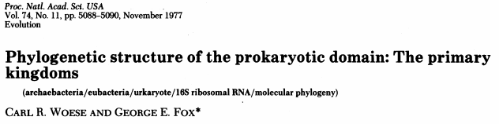
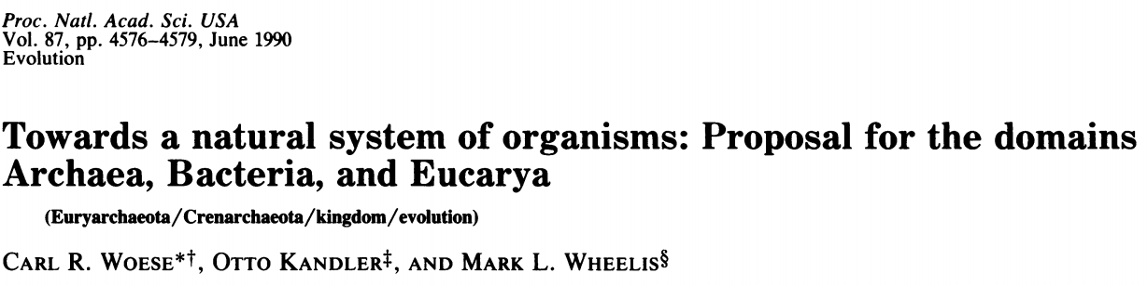
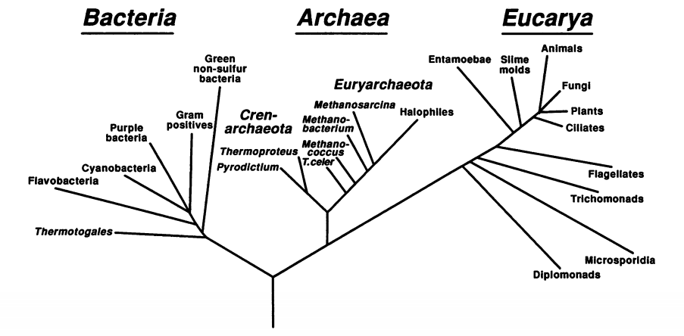

Slide 6
Ribosomal operon
Bacteria and Archaea
5’ ETS
3’ ETS
16S
tRNA
23S
5S
Eukarya
ITS
5’ ETS
3’ ETS
18S
5.8S
25S/28S
ETS: External Transcribed Spacers
ITS: Internal Transcribed Spacer
The ribosomal operon allows the general phylogenetic division of all organisms in 3 domains, this is supported by a few other markers and biochemical features. For some groups the ribosomal genes allow species identification

Slide 7
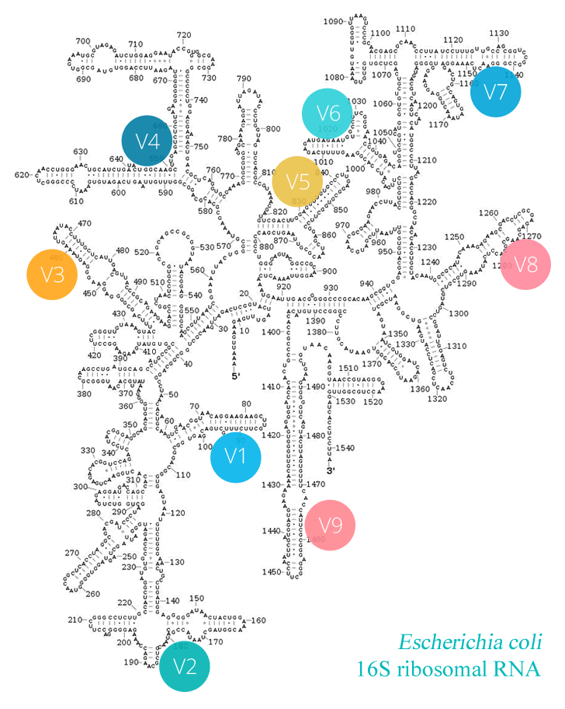
16S rRNA
https://era7bioinformatics.com/en/page.cfm?id=2716&title=full-lenght-16s-taxonomic-profiling-with-pacbio

Slide 8
What is required for accurate species-level identification?

Slide 9
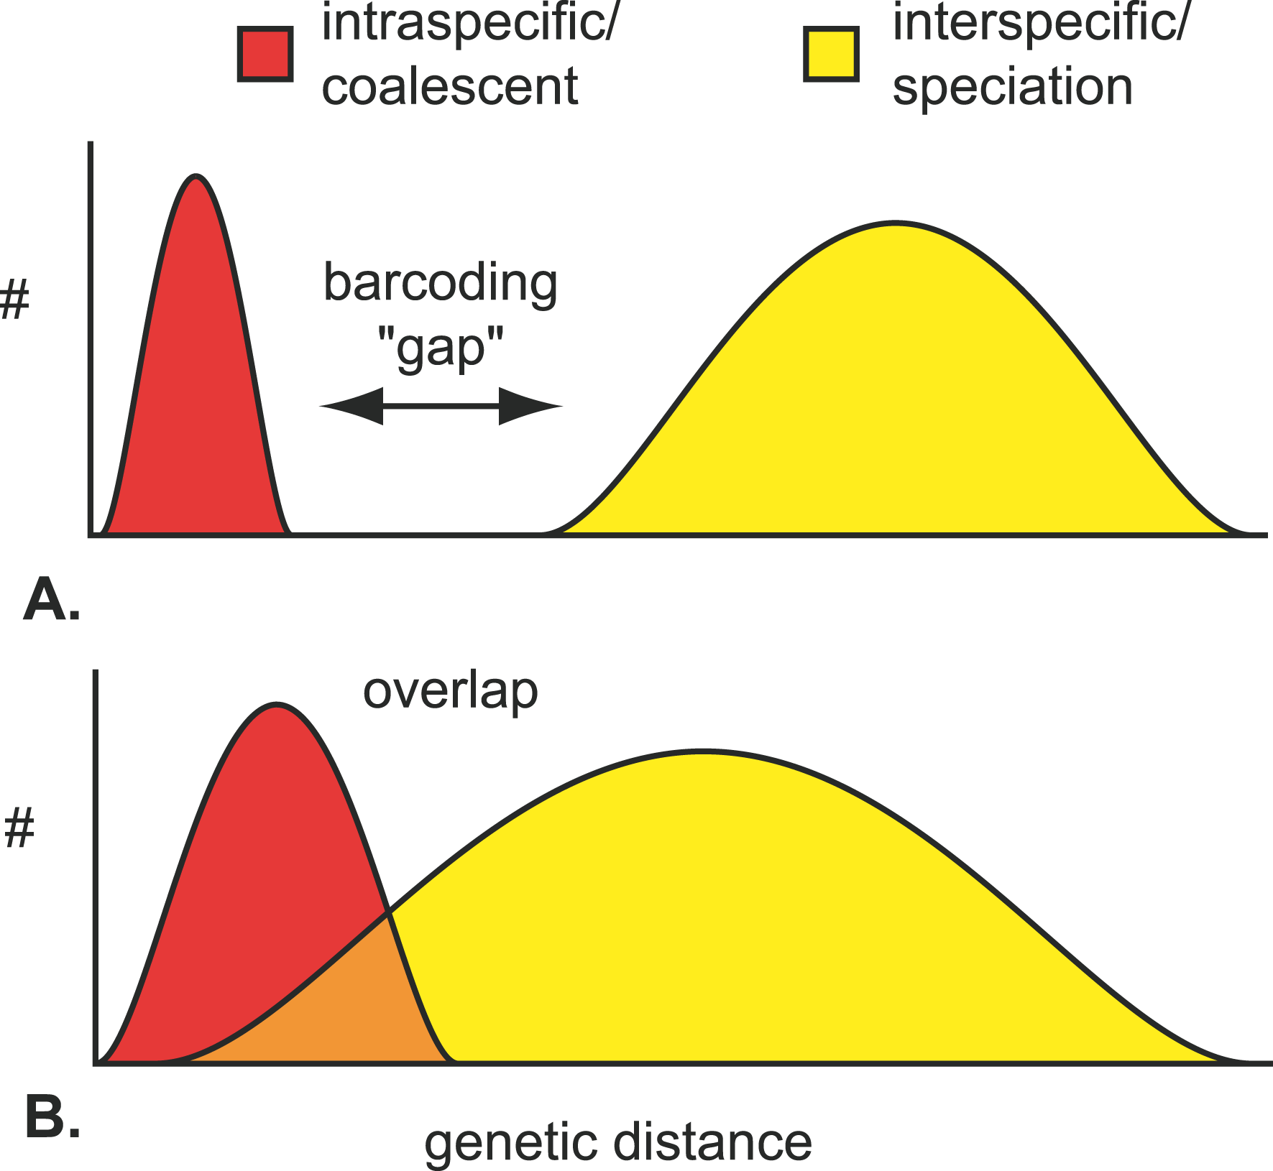
Barcoding genes and the barcode gap
The goal of DNA barcoding is the sequencing of a short fragment of DNA can be used to diagnose taxa.
For this, the proposed barcode should have a barcode gap:
For DNA barcoding to work we need a database of taxonomically labelled sequences.
The “size” of the gap, and the width of the distributions will vary for different markers, but also for a given marker will likely vary for different taxonomic groups.
Meyer & Paulay 2005

Slide 10
Some barcoding genes for different groups of organisms
https://www.ecronicon.com/ecmi/pdf/ECMI-07-00229.pdf

Slide 11
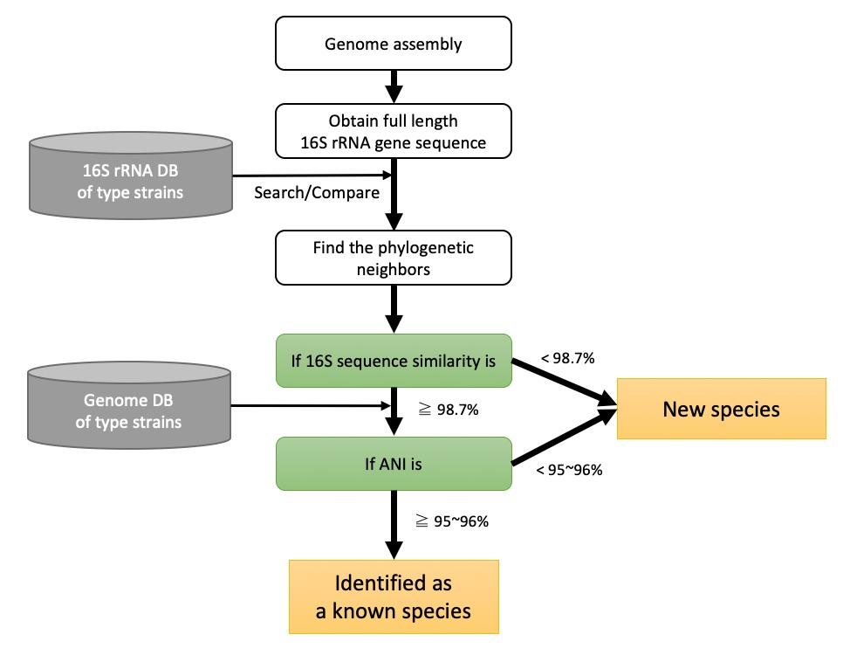
Bacterial identification
https://help.ezbiocloud.net/user-guide/truebac-id/bacterial-identification-101/

Slide 12
Example – Bacterial Identification
Go to the site: https://www.ezbiocloud.net/ and create an account.
From the repository https://github.com/labbces/smagro2019, use the files 16S_rRNA_desc1.fasta and 16S_rRNA_desc2.fasta to perform a 16S rDNA based identification.
Perform a blastn search at NCBI using the same two sequences.
Discuss with your instructor.

Slide 13
Using whole genome sequences for bacterial identification
Definitive, accurate identification
High specificity and sensitivity
Organism-agnostic
One method for all taxa
Computationally fast
Easy to perform and interpret
“Push button” solution

Slide 14
Average Nucleotide Identity (ANI)
A computational method to compare pairs of genome, one unknown query sequence to a well characterized reference genome
There are two measures computed actually:
Genetic similarity of shared sequences
Proportion of aligned bases
It was shown to closely mirror comparisons by DNA-DNA hybridization , which was the traditional gold standard method for determining species boundaries in prokaryotes
https://www.pnas.org/content/102/7/2567.long
https://academic.oup.com/nar/article/43/14/6761/2903001
https://link.springer.com/article/10.1007%2Fs10482-017-0844-4

Slide 15
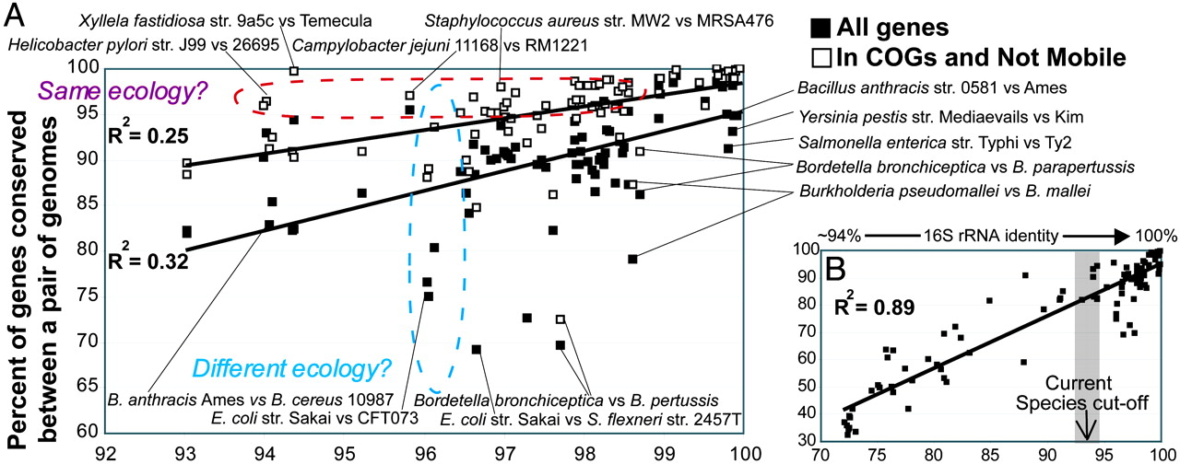
ANI the original insights
Correlation between conserved genes and evolutionary distance for bacterial species.

Slide 16
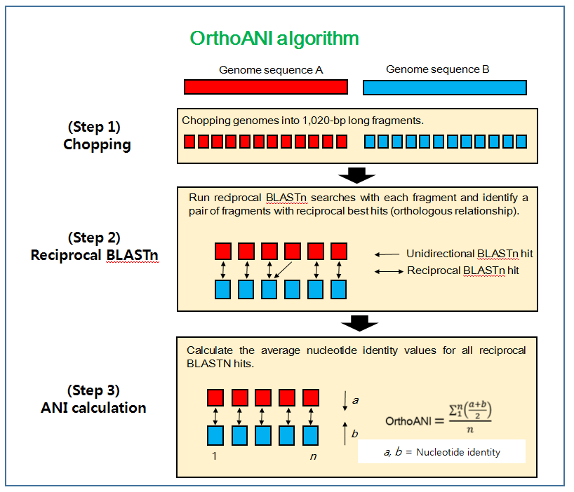
The computational methods: OrthoANI
https://www.microbiologyresearch.org/content/journal/ijsem/10.1099/ijsem.0.000760

Slide 17
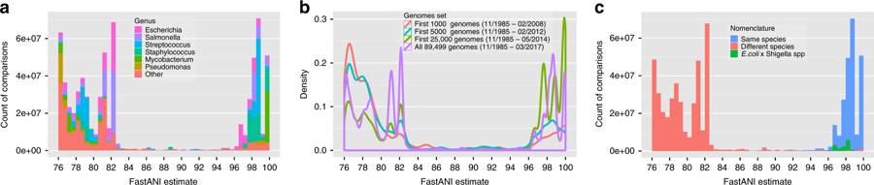
Average Nucleotide Identity (ANI)
90K genomes
https://www.nature.com/articles/s41467-018-07641-9
Notes:
Genetic discontinuity observed using 90 K genomes. a Histogram plot showing the distribution of ANI values among the 90 K genomes. Only ANI values in the 76–100% range are shown. Out of total 8.01 billion pairwise genome comparisons, FastANI reported only 17M ANI values (0.21%) with ANI between 83 and 95% indicating a genetic discontinuum. Multiple colors are used to show how genomes from different genera are contributing to this distribution. Few peaks in the histogram arise from genera that have been extensively sequenced and dominate the database. b Density curves of ANI values in the ANI range 76–100%. Each curve shows the density curve corresponding to the database at a particular time period. Discontinuity in all four curves is observed consistently. c. Distribution of ANI values with each comparison labeled by the nomenclature of genomes being compared. All the comparisons between Escherichia coli and Shigella spp. have been labeled separately. The 95% ANI threshold on x-axis serves as a valid classifier for comparisons belonging to same and different species

Slide 18
Using whole genome sequences for bacterial ID
https://www.ezbiocloud.net/contents/genome
Average Nucleotide Identity (ANI)
https://img.jgi.doe.gov/cgi-bin/m/main.cgi?section=ANI&page=pairwise (Offline 10 and 11 of September 2019)
https://www.ezbiocloud.net/tools/ani
GCF_002009885.1 vs GCF_002006205.1
GCF_002009885.1 vs GCF_002176895.1
What are the reported ANI values?
What is the aligned fraction?

Slide 19
From markers to whole genomes

Slide 20
Fungi identification
Eukarya
ITS
5’ ETS
3’ ETS
18S
5.8S
25S/28S
Recover the ITS sequence KF737866.1 from NCBI, use it as query in
http://its2.bioapps.biozentrum.uni-wuerzburg.de/ (First annotate and then use BLAST)
http://www.boldsystems.org
BLAST @ NCBI

Slide 21
END
Part II

